Slide 1
Membership and role management
Chapter 5

Slide 2
What Are You Going To Learn?
At the end of this lesson, you will be able to:
  Compare authorization and authentication
  Apply forms authentication
  Use Login Controls
  Set authorization in Web.config file
  Manage role

Slide 3
Introduction to Web Security
Websites rely on identifying users to provide access permissions to data and functions.
System information leakage Web servers, errors, staff, partner organizations, search engines and rubbish can all be the source of important information about your website - its technologies, business logic and security methods. An attacker can use such information to their advantage so it is important to avoid system information leakage as far as possible.

Slide 4
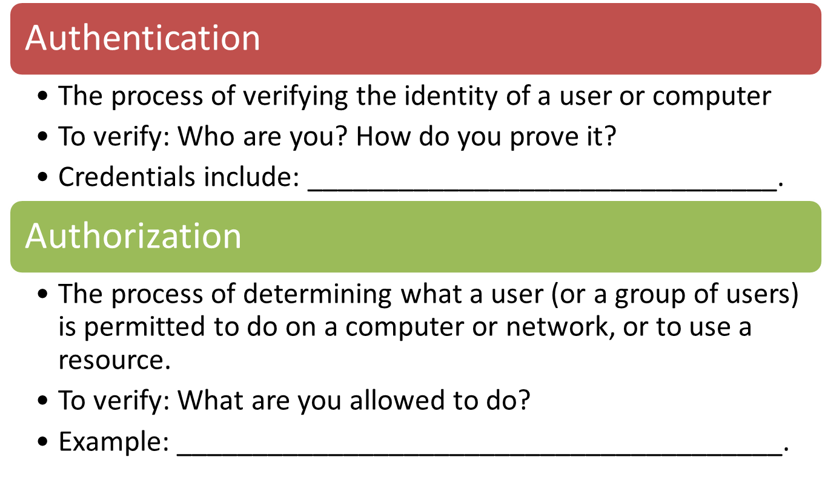
Basic Principles

Slide 5
ASP.NET Security
ASP.NET provides the membership management service
  to deal with authenticating users to access a page or an entire site.
  provides Login control to work with the end user through the process of authentication.
ASP.NET provides the role management service that covers authorization.

Slide 6
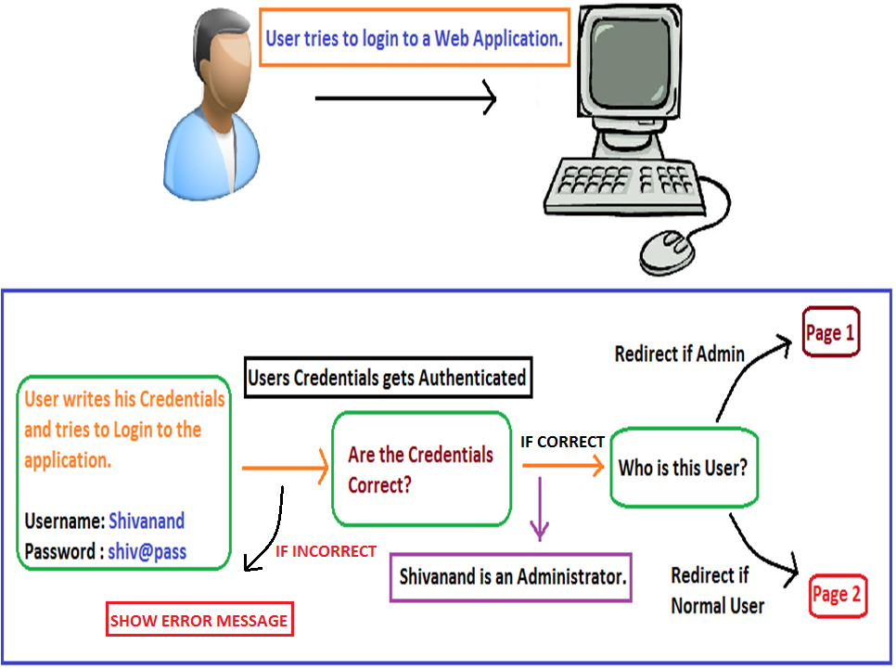
Question: Differentiate between Authentication and Authorization
B
A

Slide 7
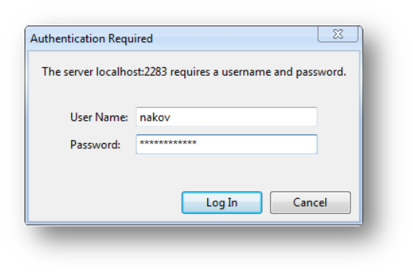
Types of authentication
Forms authentication
Windows authentication *
Microsoft Account(formerly Passport authentication) *
Social Login*
* Not covered in the syllabus

Slide 8
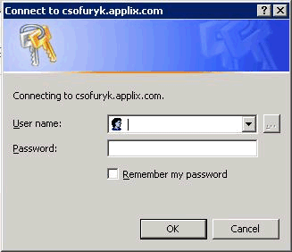
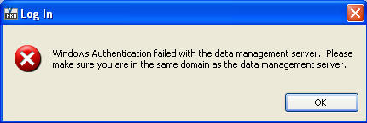
Windows Authentication
Uses Active Directory/ Windows account
Users credentials are validated with the information stored in the Windows Users Group.
Suitable for developing intranet application
It is not available in Windows 7 Home - Premium, Basic and Starter Versions.

Slide 9
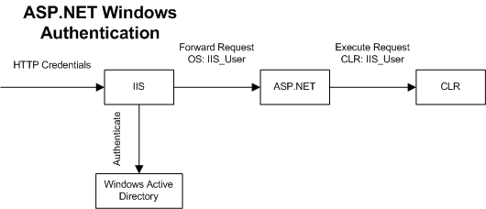


Windows authentication
Web server handles the authentication using whichever methods is configured on the virtual directory that the application is running within.
Login pages pass user credentials to a web server.

Slide 10
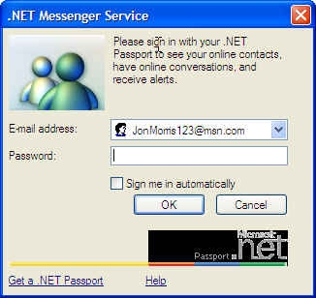
Microsoft Account/Passport
  Uses Microsoft's Account service
a centralized authentication service provided by Microsoft that offers a single logon and core profile services for member sites
Register using your existing e-mail or @hotmail.com/ @live.com/@msn.com

Slide 11
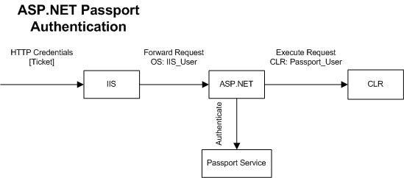

Passport Authentication
Login pages pass user credentials to a web server.
Login credentials are passed to a Microsoft Passport server where user profile are stored centrally. E.g. MSN account

Slide 12
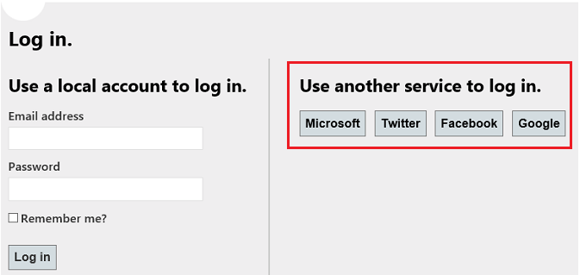
Social Authentication/Social Login
Uses OAuth and OpenID
a form of single sign-on using existing login information from a social networking service such as Facebook, Twitter or Google+ to sign into a third party website
OAuth: An open protocol to allow secure authorization in a simple and standard method from web, mobile and desktop applications
OpenID: A Simple Identity layer on top of OAuth 2.0

Slide 13
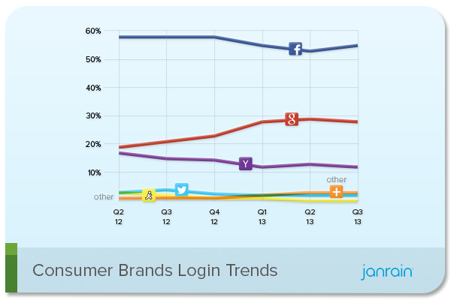
Social Login
Source: Olson, M. 2013.Social Login Trends Across the Web for Q3 2013. Janrain
For reference, visit: http://www.asp.net/web-pages/tutorials/security/enabling-login-from-external-sites-in-an-aspnet-web-pages-site

Slide 14
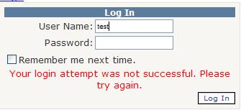
Forms Authentication
Uses traditional login/logout pages
Code associated with a Web form handles users authentication by username / password
Users are usually stored in a database

Slide 15
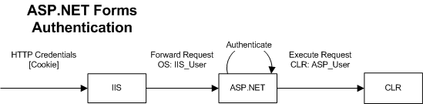

Forms Authentication
When the server receives the request, a cookie is written to the use’s local machine, and this cookie is passed back to the server & the browser along with each request that is sent so that the user remains authenticated.
Login requests are made by filling in a form on a web page and submitting that form to the server.

Slide 16
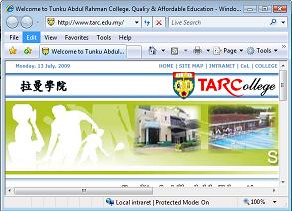


Forms Authentication Model
Request
Page A
anonymous
Send
Login Page

Slide 17


Forms Authentication Model
Login request:
Username + Password
authenticate
Page A
Cookie

Slide 18
Forms Authentication Model
Page B
Cookie
authenticate
Page B

Slide 19
Advantages and Disadvantages
Method | Advantages | Disadvantages
Windows Authentication | Suitable to be used in an existing Windows intranet infrastructure | Unsuitable if web application resides outside of organization intranet
Forms Authentication | Easy to implement | Need to maintain your own database
Microsoft Account/ Passport Authentication | Single sign-on Integrated with other services such as Windows Azure, XBox Live, and Skype. No need to maintain a database to store user information | Fees involved Windows proprietary protocol as opposed to open source such as OpenID

Slide 20
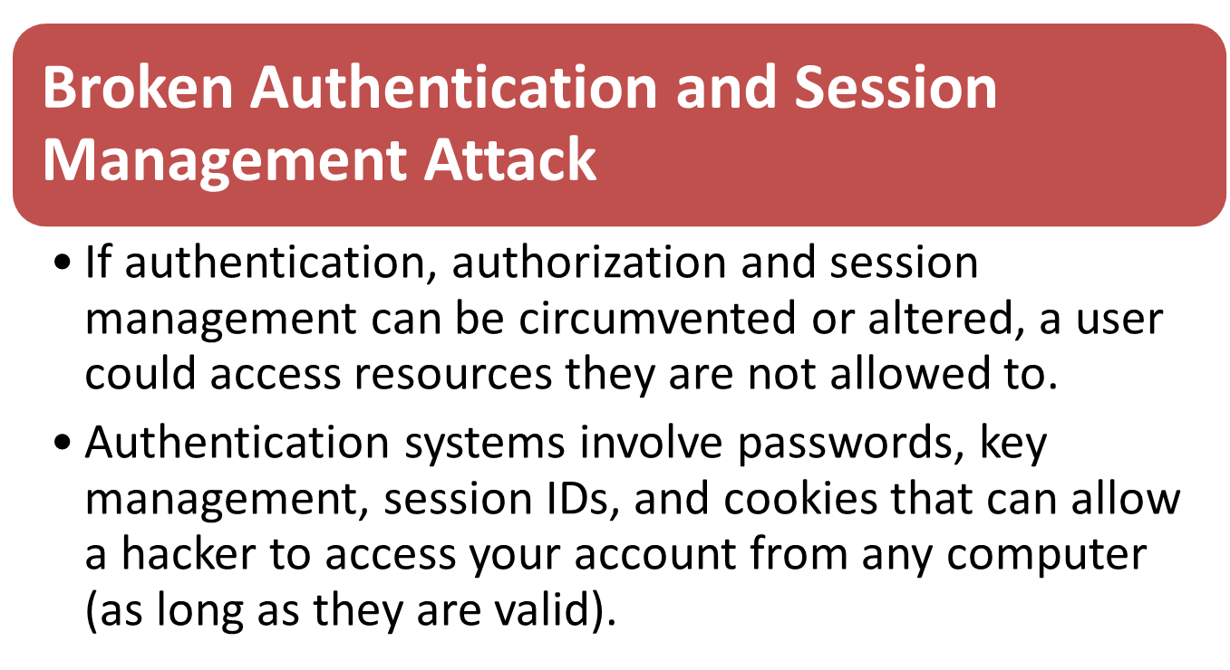
Web Security Issues

Slide 21
Security Measurement
Beware of how password reminders, remember-me, change password, log out and updating account details are handled, how session tokens are used
always have login forms on dedicated and encrypted (SSL) pages, i.e. use HTTPS (rather than HTTP)
For more reference, visit: http://www.asp.net/web-api/overview/security/ working-with-ssl-in-web-api

Slide 22
Security Measurement
Ask yourself these questions to find out if your website is vulnerable to a broken authentication and session management attack:
Are user credentials weak (e.g. stored using hashing or encryption)?
Can credentials be guessed or overwritten through weak account management functions (e.g. account creation, change password, recover password, weak session IDs)?
Are session IDs exposed in the URL (e.g. URL rewriting)?
Are session IDs vulnerable to session fixation attacks?
Do session IDs timeout and can users log out?
For more reference: visit: https://www.owasp.org/index.php/Session_fixation

Slide 23
Question
What are the three authentication provided by ASP.NET?
How Form Authentication works?

Slide 24
Forms authentication setup
Prepare your database.
  Use the aspnet_regsql tool to auto-generate and add the Membership table into your database.
Configure web.config file.
  Set up connection string to your database. Example:
<connectionStrings>
<add name="MyAppDB" connectionString="Data Source=(LocalDB)\
………;AttachDbFilename=|DataDirectory|\somedb.mdf;Integrated Security=SSPI;" />
</connectionStrings>

Slide 25
Forms authentication setup
  Add a Membership provider. Example:
<membership>
<providers>
<clear/>
<add name="AspNetSqlMembershipProvider"
type="System.Web.Security.SqlMembershipProvider"
connectionStringName=“……..“ ← MUST follow your db’s connection name
enablePasswordRetrieval="false"
enablePasswordReset="true"
requiresQuestionAndAnswer="false"
requiresUniqueEmail="false"
minRequiredPasswordLength="5"
minRequiredNonalphanumericCharacters="0"
passwordFormat="Hashed" />
</providers>
</membership>

Slide 26
Forms authentication setup
  Set the authentication mode to Forms. Example:
  Set authorization to Allow/Deny access to anonymous users in one or more files/directories in the application.
Create a login page
<authentication mode="Forms" >
<forms name=“anyname“ loginUrl="loginPage.aspx" />
</authentication>
<authorization>
<deny users="?"/>
</authorization>

Slide 27
Storage Mechanisms
Forms Authentication classes enable you to store usernames and passwords in different storage mechanisms:
  Web.config File
  Database Table
  XML File (Not covered)

Slide 28

Authenticating Users with Web.Config File
If you need to store a small number of usernames and password, you can store them directly in the Web.config file.
Hardcoded Credentials should be encrypted

Slide 29
Authenticating Users with Web.Config File
Storing User Credentials in Web.config
<system.web>
<authentication mode="Forms">
<forms name="Wrox" path="/" loginUrl="Login.aspx">
<credentials passwordFormat="Clear">
<user name="BillEvjen" password="Bubbles"/>
</credentials>
</forms>
</authentication>
</system.web>
clear / MD5 / SHA1
Storing username and password in “Clear” format is a big NO NO

Slide 30
Authenticating Users with a Database Table
The most common methods of creating a custom user registration system is to use a database table to hold usernames and password. For large Web sites, this solution is the best because it is the most scalable.

Slide 31
Using ASP.NET Login Control
Login
  Provides text boxes, buttons and built-in validation to add login functionality
CreateUserWizard
  Used to create user accounts
ChangePassword
  Allows user to change password
PasswordRecovery
  Allows user to retrieve password

Slide 32
Using ASP.NET Login Control
LoginStatus
  Give feedback to users so that they know whether they have remembered to log in to the site
  Control the login and logout processes
LoginName
  Display a user’s login name if the user has logged in using ASP.NET membership

Slide 33
Using ASP.NET Login Control
LoginView
  Display login information
  Altering the appearance of the page dependent on whether user is logged in or not
  Show different content to different groups of users

Slide 34
DEMO
Using Login Controls

Slide 35
Types of users
Many sites traditionally feature three levels of user security:
  Anonymous Users
  Registered Users
  Administrators

Slide 36
Setting in web.config file
Under the authorization element, you can set to deny or allow access to specified users.
To deny access, code a deny element and set the users and roles attributes.
To allow access, code an allow element and set the users and roles attributes.

Slide 37
Enabling User Role
To allow role management, add the following under the <system.web> element:
But you will have to code manually to add roles. Use the Role class from System.Web.Security. Functions available:
<roleManager enabled = “true”/>
Roles.CreateRole(…)
Roles.GetUsersInRole(…)
Roles.GetRolesForUser(…)
Roles.GetAllRoles(…)
Roles.AddUserToRole(…)
Roles.DeleteRole(…)

Slide 38
Setting Authorization
<system.web>
<authorization>
  <allow attribute= “value”/>
  <deny attribute=“value” />
</authorization>
</system.web>
attribute is either ‘users’ or ‘roles’
action is either ‘allow’ or ‘deny’
** attribute = “value”:
  if all users, write users=“*”
  if all unauthenticated users (anonymous) , write users=“?”
  if a specific user, write the name, e.g. users=“Eric”
  if a specific role, write the role, e.g. roles = “Admin”

Slide 39
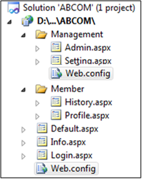
Authorization setting
Web.config setting in Management directory/folder
Web.config setting in root
<authorization>
  <allow roles = “admin” />
  <deny users=“*”/>
</authorization>
<authorization>
  <deny users=“?”/>
</authorization>

Slide 40
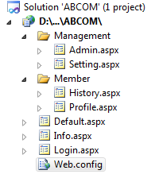
Set all requirements on a single Web.config
<!-- files in “Management” folder -->
  <location path=“Management”>
  <system.web>
  <authorization>
    <allow roles = “admin” />
    <deny users=“*”/>
  </authorization>
  </system.web>
  </location>
<!– files in root directory-->
<system.web>
  <authorization>
    <deny users=“?”/>
  </authorization>
  </system.web>

Slide 41
Apply authorization requirements to a single file
<location path=“Management/Admin.aspx”>
<system.web>
<authorization>
  <allow roles = “admin” />
  <deny users=“*”/>
</authorization>
</system.web>
</location>

Slide 42
Question
Consider there are 3 roles: admin, staff and member. Examine the code segments below, what is wrong?
<location path=“admin”>
<system.web>
<authorization>
  <allow roles = “admin” />
</authorization>
</system.web>
</location>
remark: only admin can access to all the files in the current directory
(a)
<authorization>
  <deny users=“*”/>
  <allow roles = “admin” />
</authorization>
remark: only admin can access to all the files in the current directory
(b)

Slide 43
Question
Assume that there are 2 different roles in a Web application: admin and staff. “staff” can only access the files in the root and “staff_folder”. “admin” can access to all files in the root, “admin_folder” and “staff_folder”. All users must login in order to view all the pages (except Login.aspx that is placed in the root)
Use Two (2) different approaches to demonstrate how the above can be done by inserting the necessary code in the Web.config(s).

Slide 44
DEMO
MembershipNRoleManagement (Show the web.config file settings)

Slide 45
ASP Identity
ASP Membership was designed to solve common requirements in 2005 such as username, password and profile data.
  Does not support cloud infrastructure (eg. Azure)
  Can’t use Open Web Interface for .NET (OWIN) which supports external identity providers (Facebook, Google, Twitter,…)
ASP Identity replaces ASP Membership.

Slide 46
ASP Identity
Features:
  Role provider: Same as Membership.
  Claims based: Include rich information about the user in a form similar to key-value pairs. (Beyond scope)
  Social login
  OWIN integration: A middleware that decouples the login with the authentication mechanism behind it.
  E-mail/SMS confirmation.
  Two-factor authentication.

Slide 47
Using ASP Identity
A code-first model to specify user data.
  Located at ~\Models\IdentityModels.cs
Be warned: The login controls in the Toolbox do not applies to ASP Identity.
Advisable to just use the generated login templates and change the code from there if needed.
  Such as adding roles.
  Refer: https://www.asp.net/web-forms/overview/getting-started/getting-started-with-aspnet-45-web-forms/membership-and-administration

Slide 48
State management
Next

